Slide 1


V-MODEL-VIOLETS
OVERVIEW
REQUIREMENTS
DESIGN
STATUS
DEMO
MILESTONES
ACKNOWLEDGEMENTS
QUESTIONS
OpenSpace and Climate Reanalyzer Interface
V-Model Violets

Slide 2
V-MODEL-VIOLETS
OVERVIEW
REQUIREMENTS
DESIGN
STATUS
DEMO
MILESTONES
ACKNOWLEDGEMENTS
QUESTIONS
Background
+ Project Overview

Slide 3
V-MODEL-VIOLETS
OVERVIEW
REQUIREMENTS
DESIGN
STATUS
DEMO
MILESTONES
ACKNOWLEDGEMENTS
QUESTIONS
Problem
Climate data from Climate Reanalyzer was previously only available through the website itself
Abundance of climate data but limited ways to interact with it
Solution
Create a platform so maps from Climate Reanalyzer can be viewed in the OpenSpace application
Enable the visualization of Climate Reanalyzer maps in planetariums
Provide a new tool for exploring climate datasets
Promote immersive learning

Slide 4
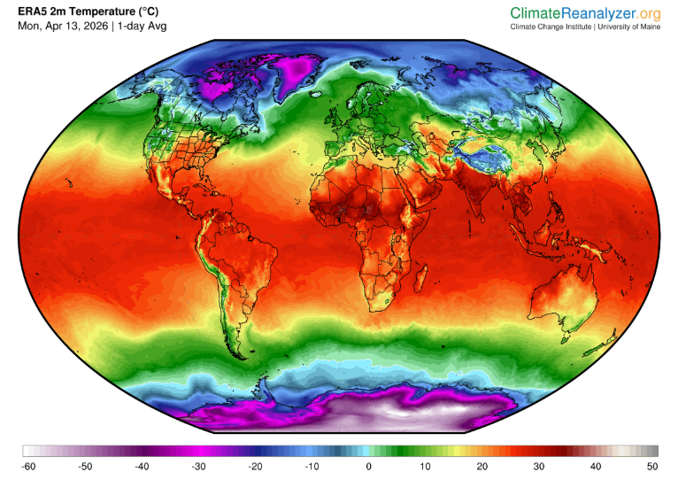
V-MODEL-VIOLETS
OVERVIEW
REQUIREMENTS
DESIGN
STATUS
DEMO
MILESTONES
ACKNOWLEDGEMENTS
QUESTIONS
What is Climate Reanalyzer?
Climate reanalysis and weather maps
Browsing historic climate data by dataset, variable, and time
Visualizing weather events and forecasts
Viewing climate trends

Slide 5

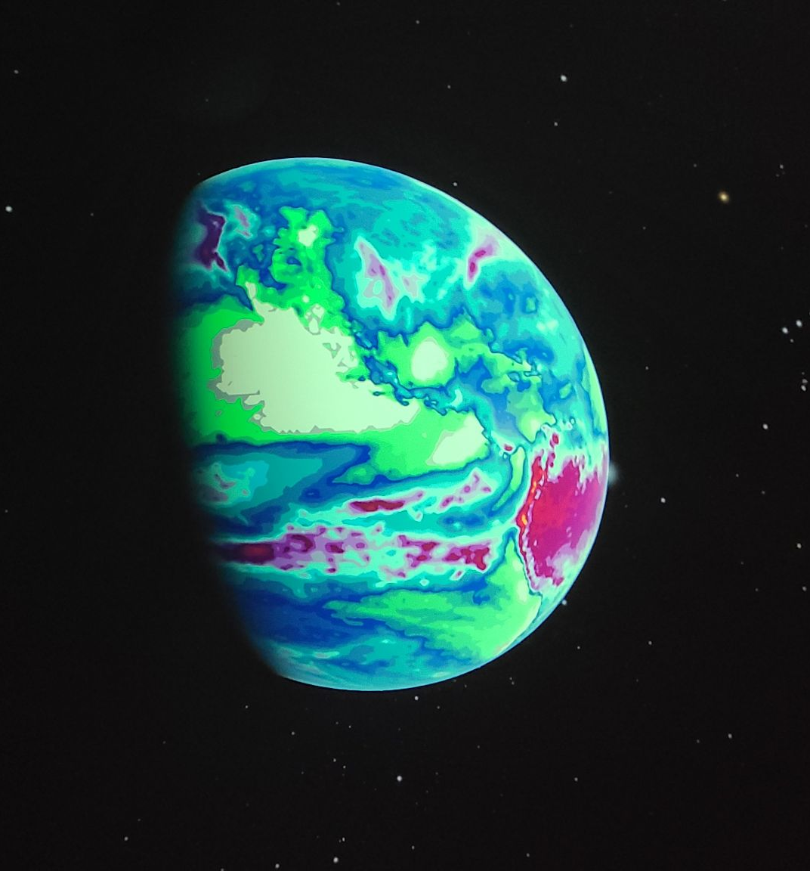
V-MODEL-VIOLETS
OVERVIEW
REQUIREMENTS
DESIGN
STATUS
DEMO
MILESTONES
ACKNOWLEDGEMENTS
QUESTIONS
What is Openspace?
Interactive space data visualization application
Project maps onto 3D globe
Images are split into tiles, which are placed on the globe for interactive viewing
Project visualizations onto planetarium screens

Slide 6
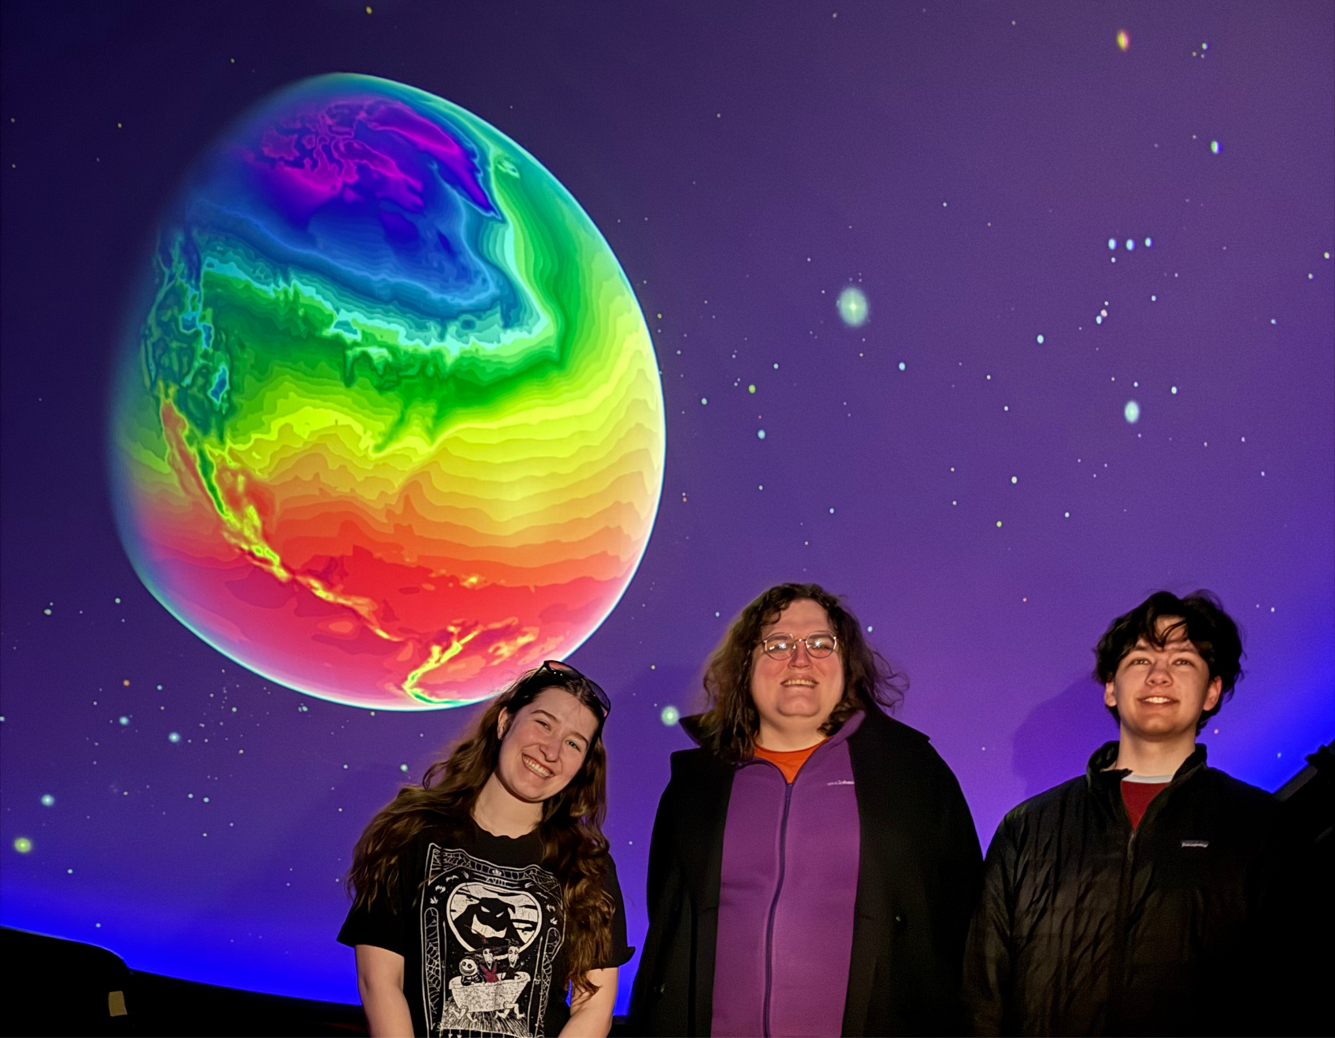
V-MODEL-VIOLETS
OVERVIEW
REQUIREMENTS
DESIGN
STATUS
DEMO
MILESTONES
ACKNOWLEDGEMENTS
QUESTIONS
Project Description
Deliver climate/weather data from Climate Reanalyzer to OpenSpace
Create image tile server to supply map segments to OpenSpace
Create interface to run within OpenSpace to browse and view available maps
Visualize climate reanalyzer maps in planetariums via OpenSpace

Slide 7
V-MODEL-VIOLETS
OVERVIEW
REQUIREMENTS
DESIGN
STATUS
DEMO
MILESTONES
ACKNOWLEDGEMENTS
QUESTIONS
System Requirements

Slide 8
V-MODEL-VIOLETS
OVERVIEW
REQUIREMENTS
DESIGN
STATUS
DEMO
MILESTONES
ACKNOWLEDGEMENTS
QUESTIONS
Functional Requirements
Map-Tile Conversion: Highest priority requirement. Our program must be able to convert to a tile-based format for OpenSpace to use successfully.
The System Listing Climate Reanalyzer Maps: The program has to have a way for users to browse for maps to display within OpenSpace. Through searching or with a calendar picker.
Multiple Tile Levels: The tiled index of maps must be created in a way that it contains multiple zoom levels for higher resolutions when zoomed into the globe within OpenSpace.
Downloading and Saving Tile Files: The program should be able to download files from our server to use locally, for instance, where planetariums may not have consistent internet connections.
Animating Maps and Tile Data: Our maps need to be created in a way that allows users to create short animated slideshows of weather events.

Slide 9
V-MODEL-VIOLETS
OVERVIEW
REQUIREMENTS
DESIGN
STATUS
DEMO
MILESTONES
ACKNOWLEDGEMENTS
QUESTIONS
Non-Functional Requirements
Performance: This category focuses on ensuring our project runs smoothly, maintains 99% uptime, and recovers from errors or maintenance restarts quickly.
Platforms: This category ensures our project works on windows machines and on Chrome, our target browser. This also includes making sure our system interacts correctly with our server and with OpenSpace.
User Experience: This category focuses on making sure the user experience is smooth, with an easy-to-understand UI.
Error Handling: This category of requirements is to make sure we have a robust system for error handling.
Code Standards: Our coding standards requirements are to make sure our code is easy to read and understand.

Slide 10
V-MODEL-VIOLETS
OVERVIEW
REQUIREMENTS
DESIGN
STATUS
DEMO
MILESTONES
ACKNOWLEDGEMENTS
QUESTIONS
System Design

Slide 11
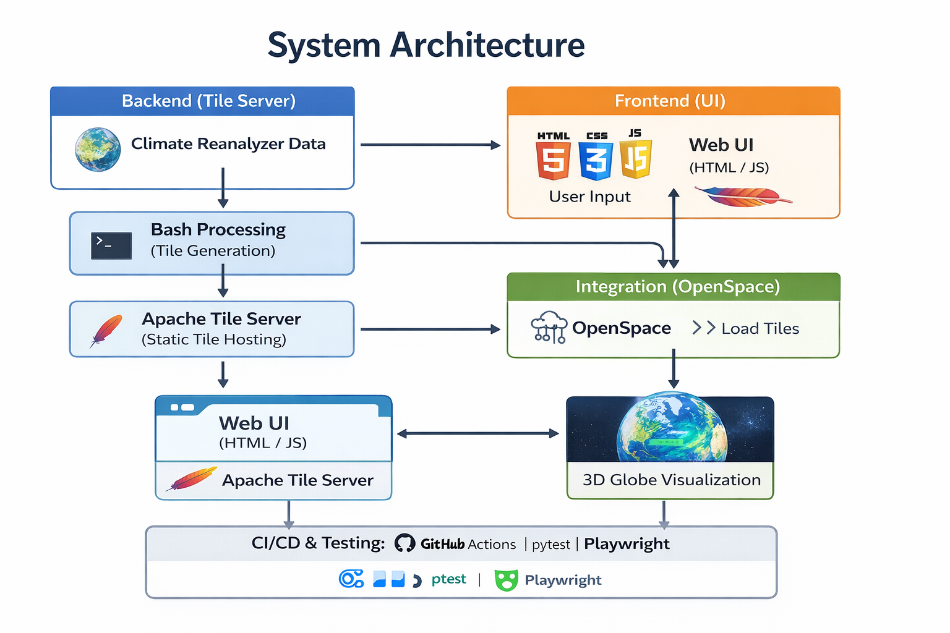
V-MODEL-VIOLETS
OVERVIEW
REQUIREMENTS
DESIGN
STATUS
DEMO
MILESTONES
ACKNOWLEDGEMENTS
QUESTIONS
Project Architecture Overview.
Architecture differs from traditional single frontend–backend models
Designed as two cooperating application components rather than one monolithic app
Image Tile Server
Hosts large, translated images served as tiles
Provides URL-accessible image data for other system components
Acts as the primary data source for visualization
User Interface Component
Serves as a separate application that consumes the tile server’s data
Integrates with OpenSpace imports for seamless use inside the Open Space environment
System Interaction
UI fetches image tiles directly from the tile server
Both components work together to deliver a unified OpenSpace experience
False Starts.

Slide 12
V-MODEL-VIOLETS
OVERVIEW
REQUIREMENTS
DESIGN
STATUS
DEMO
MILESTONES
ACKNOWLEDGEMENTS
QUESTIONS
Testing

Slide 13
V-MODEL-VIOLETS
OVERVIEW
REQUIREMENTS
DESIGN
STATUS
DEMO
MILESTONES
ACKNOWLEDGEMENTS
QUESTIONS
GitHub Actions Integration — Both the Playwright end-to-end suite and the unit testing suite are fully automated and run on every push via GitHub Actions, alongside the commit message validator.
Playwright End-to-End Tests — 100% coverage of user-facing actions, ensuring every interaction a user can take has been tested and verified to work as expected.
Unit Tests — Full coverage of all implemented functions on both the frontend and backend, validating component behavior and preventing regressions as the codebase evolves.
Tile Server URL Checks — Automated verification that tile server image sets are accessible via URL, catching broken links and misconfigurations before they reach deployment.
Strengthened CI/CD — The combined test suite acts as a reliable safety net, giving the team confidence that the pipeline will catch issues at every stage before they ship.

Slide 14
V-MODEL-VIOLETS
OVERVIEW
REQUIREMENTS
DESIGN
STATUS
DEMO
MILESTONES
ACKNOWLEDGEMENTS
QUESTIONS
DevOps

Slide 15
V-MODEL-VIOLETS
OVERVIEW
REQUIREMENTS
DESIGN
STATUS
DEMO
MILESTONES
ACKNOWLEDGEMENTS
QUESTIONS
CI/CD Pipeline — Enforces consistency across the codebase and catches issues early by automatically running checks on every push and pull request, preventing broken code from reaching production.
Commit Message Validator — Standardizes commit formatting across all contributors, improving traceability and making the project history easier to navigate and audit.
Code Reviews — All changes go through peer review to ensure quality, distribute knowledge across the team, and surface bugs before they're merged.
Husky Pre-Commit Hooks — Linting and style checks run automatically before every commit, keeping the codebase clean and consistent without relying on manual discipline.

Slide 16
V-MODEL-VIOLETS
OVERVIEW
REQUIREMENTS
DESIGN
STATUS
DEMO
MILESTONES
ACKNOWLEDGEMENTS
QUESTIONS
User Interface
&
Project Demo

Slide 17
V-MODEL-VIOLETS
OVERVIEW
REQUIREMENTS
DESIGN
STATUS
DEMO
CONCLUSIONS
ACKNOWLEDGEMENTS
QUESTIONS
Conclusions

Slide 18
V-MODEL-VIOLETS
OVERVIEW
REQUIREMENTS
DESIGN
STATUS
DEMO
CONCLUSIONS
ACKNOWLEDGEMENTS
QUESTIONS
Unmet Requirements
Downloading and Saving Tile Files: Low priority requirement. Offline use was not a huge concern from the start and was not met.
Animating Maps and Tile Data: Stretch goal requirement. This had been talked about early on as something cool if we had time.

Slide 19
V-MODEL-VIOLETS
OVERVIEW
REQUIREMENTS
DESIGN
STATUS
DEMO
CONCLUSIONS
ACKNOWLEDGEMENTS
QUESTIONS
What Went Well vs What Didn’t
What Went Well
Communication
Overall Development
Motivation/Passion
Technical aspects of Server Integration
What Didn’t Go Well
Timeline
Server Integration
Data Accumulation

Slide 20
V-MODEL-VIOLETS
OVERVIEW
REQUIREMENTS
DESIGN
STATUS
DEMO
MILESTONES
ACKNOWLEDGEMENTS
QUESTIONS
Acknowledgements
Thank you Dr. Sean Birkel, Shawn Laatsch, Dr. Carter Emmart, Micah Acinapura, and Dr. Terry Yoo
Additional thanks to the Climate Change Institute and the Versant Power Astronomy Center at the University of Maine.

Slide 21
V-MODEL-VIOLETS
OVERVIEW
REQUIREMENTS
DESIGN
STATUS
DEMO
MILESTONES
ACKNOWLEDGEMENTS
QUESTIONS
Q&A

